Slide 1


Week- 5 Agile Methods Manifesto; Values; Principles; Dr. Bhuvan UNHELKAR IT Faculty, College Of Business; Office: C225; bunhelkar@sar.usf.edu; 941-359-4654

Slide 2

Agenda
What Comprises Agile?
The Agile Manifesto, Agile Values, and 12 Agile Principles (Pages 35 to 42; and Page 47)
Core Agile values and behaviors (9 of them)
Agile Principles (Table 2.3)
Agile principles into 4 categories: Customer-centric, Developer-centric, Architecture-centric and Management-centric (Figure 2.2).
"A Practical Agile Manifesto“ (Pages 59 – 62)
What is Scrum? And Introduction (Page 47)
Summary & Consolidation

Slide 3
Agenda-2 (Based on the Book)
Scrum in Detail (Pages 47 – 49)
Lean (Pages 51 – 52)
Kaizen (Pages 53 – 54)
SAFe – Scalable Agile Framework
DAD – Disciplined Agile Delivery

Slide 4

Sub-Module What Comprises Agile?
Major Concepts
© MethodScience; Material Designed and Presented by Dr. B. Unhelkar

Slide 5
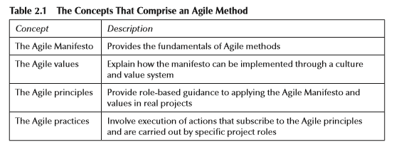

Slide 6
Sub-Module The Agile Manifesto
The Core (Foundation) of Agile
© MethodScience; Material drawn from The Art of Agile Practice (B. Unhelkar)

Slide 7
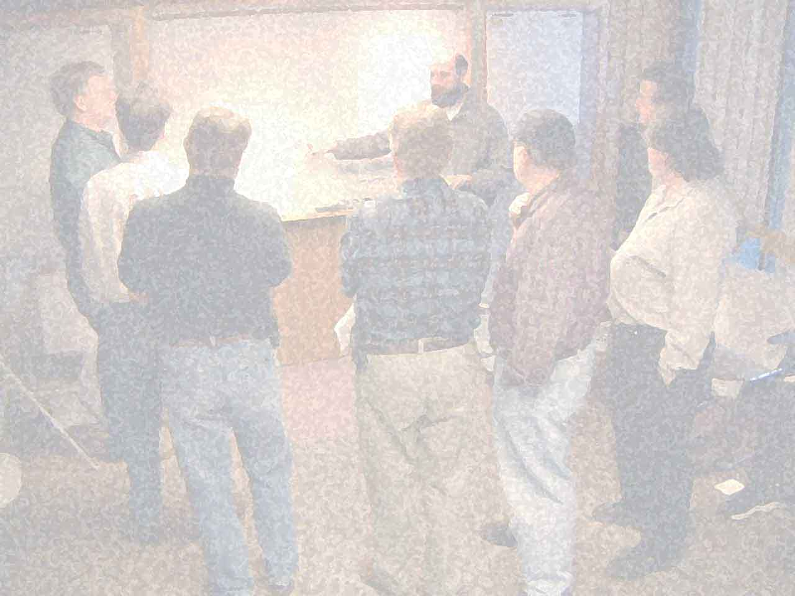
Manifesto for Agile Software Development: Agile Manifesto http://agilemanifesto.org/
We are uncovering better ways of developing software by doing it and helping others do it. Through this work we have come to value:
Individuals and interactions over processes and tools
Working software over comprehensive documentation
Customer collaboration over contract negotiation
Responding to change over following a plan
Notes:
The meanings of the manifesto items on the left within the agile software development context are described below.
Individuals and Interactions – in agile development, self-organization and motivation are important, as are interactions like co-location and pair programming. Working software – working software will be more useful and welcome than just presenting documents to clients in meetings. Customer collaboration – requirements cannot be fully collected at the beginning of the software development cycle, therefore continuous customer or stakeholder involvement is very important. Responding to change – agile development is focused on quick responses to change and continuous development.^{[6]}

Slide 8
Short Exercise
Fill in the Blanks:
Individuals and ________over processes and ________
_________software over comprehensive _______________
Customer ____________ over ____________ negotiation
Responding __________ over following a_________

Slide 9

Discussion, Q & A, Workshop
Take any ONE of the four statements of the Manifesto: and Argue FOR and AGAINST it – using Examples
Why do you think the Agile Manifesto is so revolutionary?
What change you would have suggested if you were one of the Signatory to the Manifesot?

Slide 10
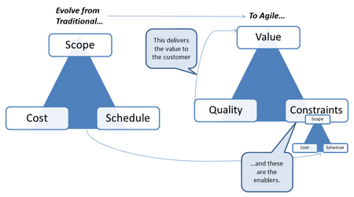
The “Agile Triangle”
Measuring performance in ways that encourage agility instead of discouraging it
Jim Highsmith; Agile Project Management
Notes:
an updated “triangle” of drivers on a project – traditional project management looks at the three aspects of “cost, schedule and scope” as the dimensions of control on a project. The Agile triangle has Value, Quality and Constraints as the dimensions. The traditional iron triangle elements define the constraints within which the project must deliver value and quality.

Slide 11
Sub-Module Agile Values
9 Values that form the basis of Agile
© MethodScience; Material Designed and Presented by Dr. B. Unhelkar

Slide 12
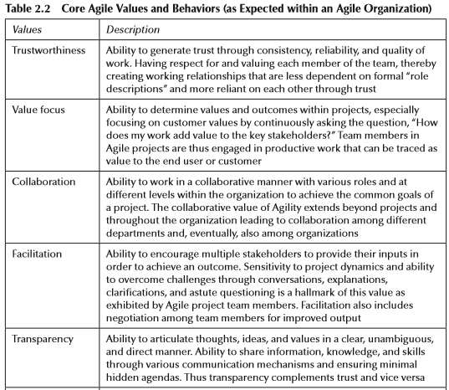

Slide 13
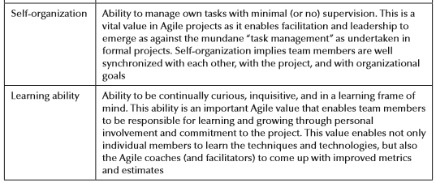
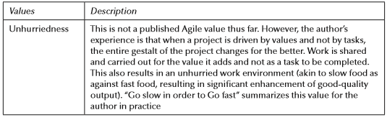

Slide 14
Discussion, Q & A, Workshop
Compare any TWO Agile Values: discuss how they support (or not support) each other.
While Agile Value makes minimal sense to you? Which one makes the most sense?

Slide 15
Sub-Module Agile Principles
X 12 – followed in Practice
© MethodScience; Material Designed and Presented by Dr. B. Unhelkar

Slide 16
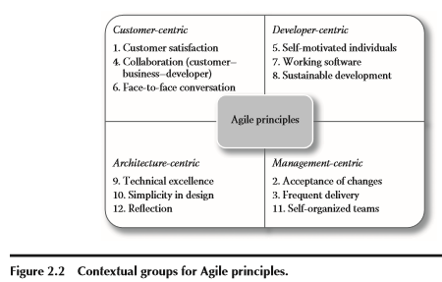

Slide 17
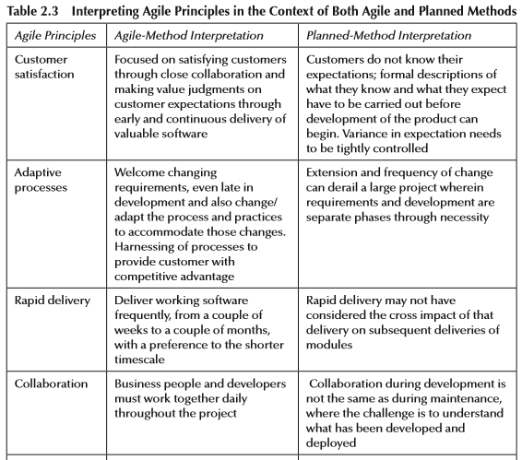

Slide 18
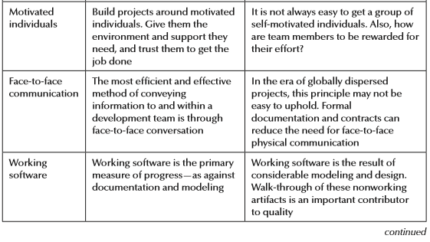

Slide 19
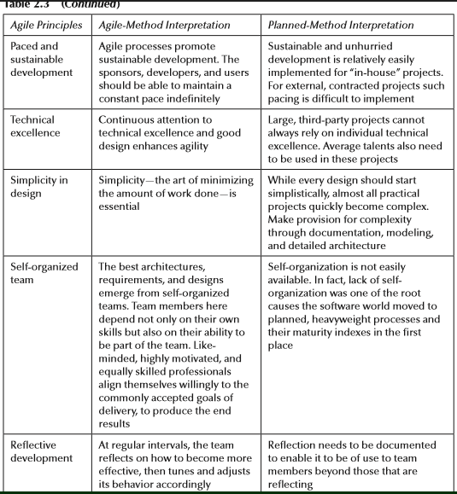

Slide 20
Discussion, Q & A, Workshop
Select any ONE Agile principle from the Contextual group of Agile principles
Write one sentence on WHY the Agile principle you selected belongs to that particular Contextual group?
Write 1-2 sentences on its Agile Interpretation and corresponding Planned method Interpretation

Slide 21
Sub-Module A Practical Agile Manifesto
Fundamental of a Composite Approach to Projects
© MethodScience; Material Designed and Presented by Dr. B. Unhelkar

Slide 22
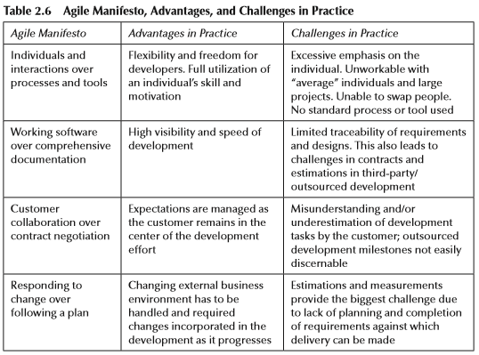

Slide 23
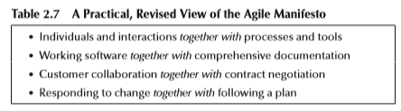

Slide 24
Discussion, Q & A, Workshop
Identify and discuss an EXAMPLE of the Advantage and Challenge of one statement of the Agile Manifesto in Practice.
Discuss why the modified and practical Agile Manifesto is a Better representation of real-life Projects.

Slide 25
Sub-Module What is Scrum?
The basics of an Agile Method primarily used in Software Development
© MethodScience; Material Designed and Presented by Dr. B. Unhelkar

Slide 26
What is Scrum?
A lightweight, iterative-incremental Process
Immediate Value to the Customer (User)
Together the Team sets a Shared and Achievable Goal
Then Sprints towards the Goal
Philosophy: Results-oriented rather than Effort-driven!
Facilitation is the key for the Coach

Slide 27
Origins of Scrum
An article was written by Hirotaka Takeuchi and Ikujiro Nonaka in 1986 which described the new approach of product development.
Article compared the product development team to a rugby team
In the early 90s, adaptations of this new approach were being implemented
Jeff Sutherland, John Scumniotales, and Jeff McKenna at Easel Corporation (First to call it “Scrum”)
Ken Schwaber at Advanced Development Methods
Scrum was presented with it’s new term at OOPSLA ‘95 by Jeff Sutherland and Ken Schwaber in a collaborative paper.

Slide 28
Agile v/s Scrum
Scrum is NOT the only Agile approach but is the most popular of All
Scrum, together with eXtreme Programming has changed the Paradigm of Software Development
Lead to a style of working that is applicable Across entire Organization
Still leaves questions in terms of Maintenance and other Infrastructure projects

Slide 29
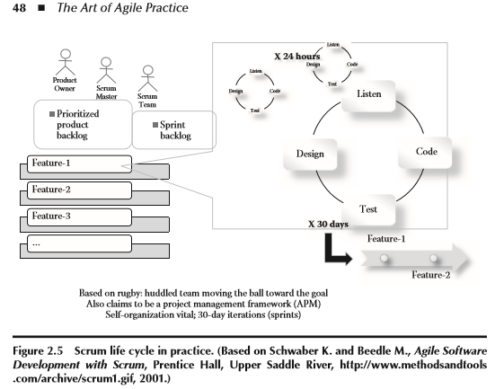
Review Figure 2.5: (We are going to discuss Scrum in great detail in subsequent lectures)

Slide 30

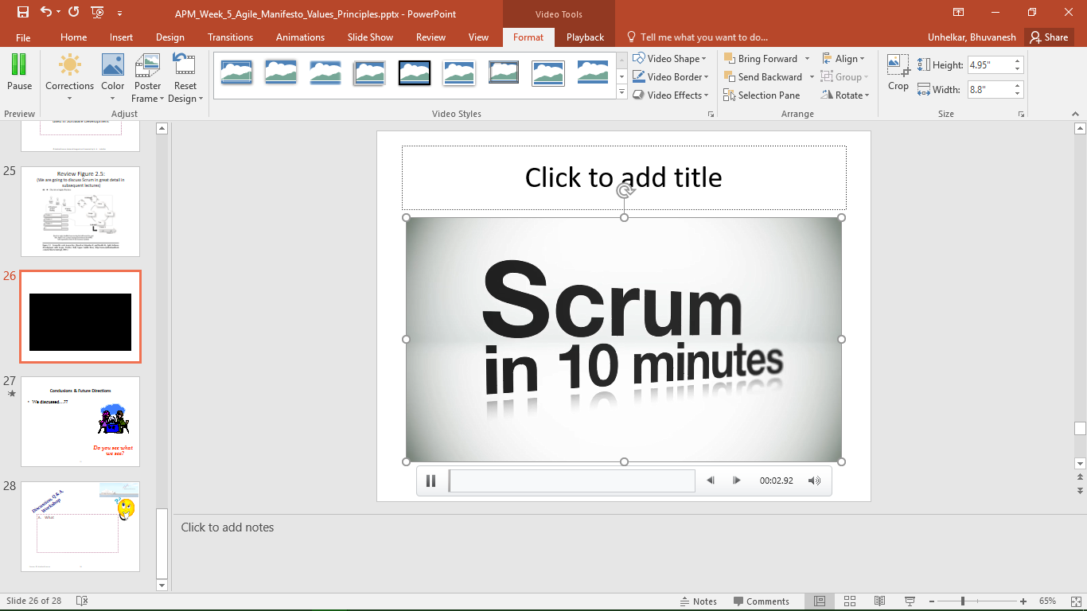
Video Intro to Scrum (in 9 mins by Hameed Shojaee)

Slide 31
Discussion, Q & A, Workshop
What is the key message you picked up by watching the video introduction to Scrum?
Why? – explain and reason.

Slide 32
Sub-Module Lean
Complimenting Agile – has a manufacturing origin
© MethodScience; Material Designed and Presented by Dr. B. Unhelkar; drawn from The Art of Agile Practice

Slide 33
Lean development is the Agile approach that has come out of the manufacturing sector.
Lean, also known as Lean manufacturing, Lean production, and Lean business process, is a business improvement methodology that focuses on maximizing customer value while minimizing waste (Lean, 2009).
The main goal of Lean is to provide the customer with more value while using fewer resources by reducing the slack between activities. Lean principles and practices are very similar to those of Kaizen.

Slide 34
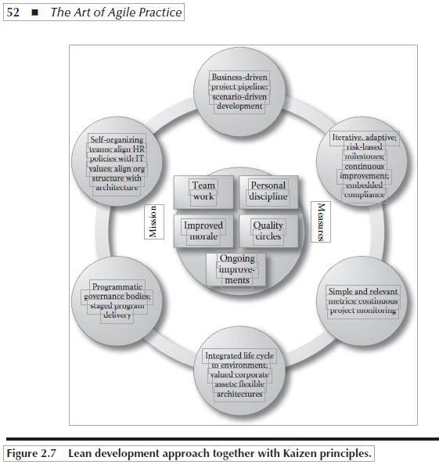
Lean and Kaizen

Slide 35
Sub-Module Kaizen & the Kanban Board
Continuous Improvement – visible to all on the Wall
© MethodScience; Material Designed and Presented by Dr. B. Unhelkar; drawn from The Art of Agile Practice

Slide 36
What is Kaizen?
Kaizen can be considered as a business strategy that is based around continuous improvement in areas of work within an organization that contribute to the goals and results of the organization.
Kaizen includes aspects of technology, leadership, quality, costs, productivity, employee satisfaction, security, and company culture.
Kaizen is an approach that includes all staﬀ in the organization to participate in the process of continuous and ongoing improvement.
There are ﬁve founding elements in Kaizen that are shown in the middle of Figure 2.7.

Slide 37
Kaizen Elements (We will repeat this once again later in the Course – when we build a Wall)
Team Work
Personal Discipline
Improved Morale
Quality Circles
Ongoing Improvement

Slide 38
Sub-Module Scalable Agile Framework (SAFe)
Agile at an Enterprise Level
(as against a Team level)
© MethodScience; Material Designed and Presented by Dr. B. Unhelkar; drawn from The Art of Agile Practice

Slide 39
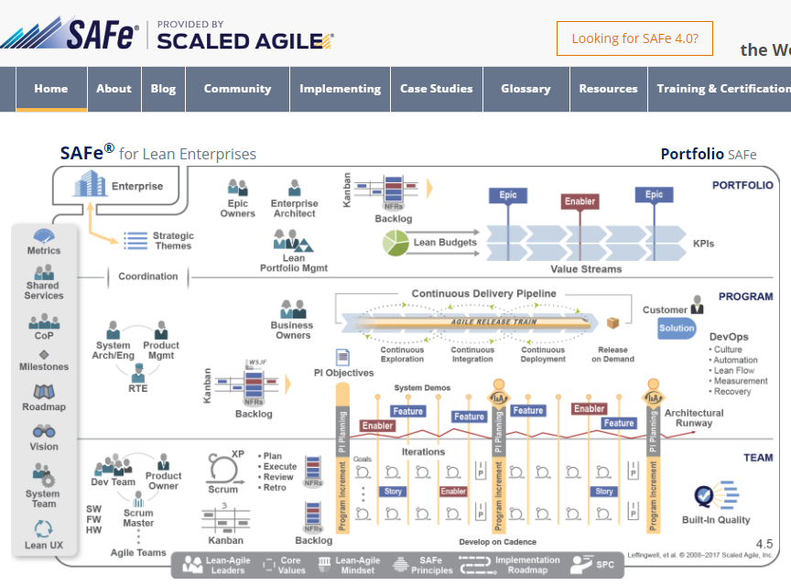
http://www.scaledagileframework.com/

Slide 40
Sub-Module Disciplined Agile Delivery (DAD)
Delivery Focus for the Enterprise
© MethodScience; Material Designed and Presented by Dr. B. Unhelkar; drawn from The Art of Agile Practice

Slide 41
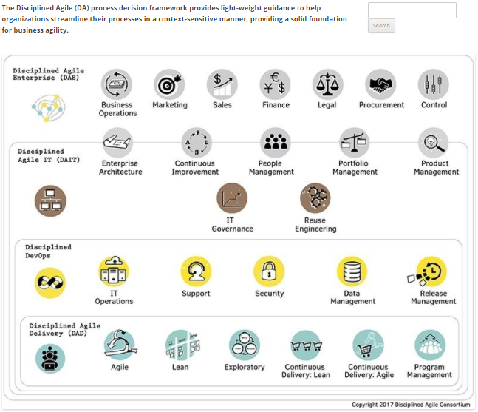
http://www.disciplinedagiledelivery.com/

Slide 42
Conclusions & Future Directions
We discussed…??
Do you see what we see?

